Slide 1
Review: Constrained Policy Optimization
07/09/24
Euiseok Han

Slide 2
Abstract
Previous study
Mnih, Volodymyr, Kavukcuoglu. Human-level control through deep reinforcement learning. Nature, 518(7540):529–533, 2015. ISSN 0028-0836. doi: 10.1038/nature14236. URL http://dx.doi.org/10.1038/nature14236.
Mnih, Volodymyr, Badia. Asynchronous Methods for Deep Reinforcement Learning. pp. 1–28, 2016. URL http://arxiv.org/abs/1602.01783.
Schulman, John, Moritz. Trust Region Policy Optimization. International Conference on Machine Learning, 2015.
Levine, Sergey, Finn, Chelsea, Darrell. End-to-End Training of Deep Visuomotor Policies. Journal of Machine Learning Research, 17:1–40, 2016. ISSN 15337928. doi: 10.1007/s13398-014-0173-7.2.
Pros: Enabled high dimensional control
Cons: no constrained setting
What more convenient in ML: reward function + constraints.
→ Constrained Policy Optimization(CPO)
why bad? Suppose industrial robot arm learning…
In real world, some behaviors → damage itself, plant around it, harmful to people working nearby

Slide 3
Abstract
Constrained Policy Optimization
Why unique?: first general-purpose policy search algorithm for constrained reinforcement learning
What for?
How to demonstrate effectiveness
: simulated robot locomotion tasks (agent satisfy constraints motivated by safety)
train neural network policies for high-dimensional control
guarantees policy behavior all throughout training
expected returns of two policies
prove a bound btw:
average divergence between policies

Slide 4
Discussion
Constrained Policy Optimization
CPO → policy search algorithm for CMDPs
demonstrated
In conclusion…
step towards by applying RL in the real world
where constraints on agent behavior are sometimes necessary for the sake of safety.
high-dimensional control
guarantees policy behavior all throughout training
thousands of parameters
Maximizing reward
Approximately satisfying constraints

Slide 5
Introduction
Deep RL: assume agents are free to explore any behavior during learning
In real: complete free agent may unacceptable
Moldovan, Teodor Mihai and Abbeel, Pieter. Safe Exploration in Markov Decision Processes. Proceedings of the 29th International Conference on Machine Learning, 2012. URL
http://arxiv.org/abs/1205.4810.
Amodei, Dario, Olah, Chris, Steinhardt, Jacob, Christiano, Paul, Schulman, John, and Man´e, Dan. Concrete Problems in AI Safety. arXiv, 2016. URL http://arxiv.org/abs/1606.06565.
Standard and well-studied RL w/ constraint: Constrained Markov Decision Process (CMDP) framework
known: optimal policies for finite CMDPs
not known: methods for high-dimensional control
How to search policy?
Heuristic algorithms for policy search in CMDP
Uchibe, Eiji and Doya, Kenji. Constrained reinforcement learning from intrinsic and extrinsic rewards. 2007 IEEE 6th International Conference on Development and Learning, ICDL, (February):163–
168, 2007. doi: 10.1109/DEVLRN.2007.4354030.
primal-dual methods can be shown to converge to constraint-satisfying policies
Chow, Yinlam, Ghavamzadeh, Mohammad, Janson, Lucas, and Pavone, Marco. Risk-Constrained Reinforcement Learning with Percentile Risk Criteria. Journal of Machine Learning Research,
1(xxxx):1–49, 2015.
→ no policy search in continuous CMDPs guarantees every policy during learning

Slide 6
Introduction
How to improve algorithm?
: new theoretical result bounds difference between the rewards or costs of two different policies.
i.e. tightens known bounds for policy search using trust regions and
provides a tighter connection between the theory and practice of policy search for deep RL.
Kakade, Sham and Langford, John. Approximately Optimal Approximate Reinforcement Learning. Proceedings of the 19th International Conference on Machine Learning, pp. 267–274, 2002. URL
http://www.cs.cmu.edu/afs/cs/Web/People/jcl/papers/aoarl/Final.pdf.
Known bounds for policy
(trust region)
Tighten practice of policy search

Slide 7
Related Work
Comprehensive overview of safety in RL
Garc´ıa, Javier and Fern´andez, Fernando. A Comprehensive Survey on Safe Reinforcement Learning. Journal of Machine Learning Research, 16:1437–1480, 2015. ISSN 15337928.
Safe policy search method with policy gradient
Uchibe, Eiji and Doya, Kenji. Constrained reinforcement learning from intrinsic and extrinsic rewards. 2007 IEEE 6th International Conference on Development and Learning, ICDL, (February):163–168, 2007. doi: 10. 1109/DEVLRN.2007.4354030.
Cons: can’t prevent policy unsafe in the first place.
theoretically-motivated policy gradient method for lifelong learning with safety constraints
Bou Ammar, Haitham, Tutunov, Rasul, and Eaton, Eric. Safe Policy Search for Lifelong Reinforcement Learning with Sublinear Regret. International Conference on Machine Learning, 37:19, 2015. URL http://arxiv.org/abs/1505.0579.
Cons: involves an expensive inner loop optimization / assumes that safety constraints are linear
primal-dual subgradient method for risk-constrained reinforcement learning
Chow, Yinlam, Ghavamzadeh, Mohammad, Janson, Lucas, and Pavone, Marco. Risk-Constrained Reinforcement Learning with Percentile Risk Criteria. Journal of Machine Learning Research, 1(xxxx):1–49, 2015.

Slide 8
Related Work
application to the deep RL setting
robotic manipulation,
Held, David, Mccarthy, Zoe, Zhang, Michael, Shentu, Fred, and Abbeel, Pieter. Probabilistically Safe Policy Transfer. In Proceedings of the IEEE International Conference on Robotics and Automation (ICRA), 2017.
Cons: can’t prevent policy unsafe in the first place.
‘intrinsic fear’ heuristic, motivate agents to avoid rare but catastrophic events.
Lipton, Zachary C., Gao, Jianfeng, Li, Lihong, Chen, Jianshu, and Deng, Li. Combating Deep Reinforcement Learning’s Sisyphean Curse with Intrinsic Fear. In arXiv, 2017. ISBN 2004012439. URL http://arxiv.org/abs/1611.01211.
Cons: assumptions restrict applicability
avoid enforcing constraints on parametrized policies by decomposing ‘desires’ from trajectory planning
neural network policy learns desires for behavior / trajectory planning algorithm selects final behavior and enforces safety.
Shalev-Shwartz, Shai, Shammah, Shaked, and Shashua, Amnon. Safe, Multi-Agent, Reinforcement Learning for Autonomous Driving. arXiv, 2016. URL http://arxiv.org/abs/1610.03295.
This study
first policy search algorithm for CMDPs that both
guarantees constraint satisfaction throughout training
works for arbitrary policy classes (including neural networks).

Slide 9
Related Work
application to the deep RL setting
robotic manipulation,
Held, David, Mccarthy, Zoe, Zhang, Michael, Shentu, Fred, and Abbeel, Pieter. Probabilistically Safe Policy Transfer. In Proceedings of the IEEE International Conference on Robotics and Automation (ICRA), 2017.
Cons: can’t prevent policy unsafe in the first place.
‘intrinsic fear’ heuristic, motivate agents to avoid rare but catastrophic events.
Lipton, Zachary C., Gao, Jianfeng, Li, Lihong, Chen, Jianshu, and Deng, Li. Combating Deep Reinforcement Learning’s Sisyphean Curse with Intrinsic Fear. In arXiv, 2017. ISBN 2004012439. URL http://arxiv.org/abs/1611.01211.
Cons: assumptions restrict applicability
avoid enforcing constraints on parametrized policies by decomposing ‘desires’ from trajectory planning
neural network policy learns desires for behavior / trajectory planning algorithm selects final behavior and enforces safety.
Shalev-Shwartz, Shai, Shammah, Shaked, and Shashua, Amnon. Safe, Multi-Agent, Reinforcement Learning for Autonomous Driving. arXiv, 2016. URL http://arxiv.org/abs/1610.03295.
This study
first policy search algorithm for CMDPs that both
guarantees constraint satisfaction throughout training
works for arbitrary policy classes (including neural networks).

Slide 10


Markov Decision Process
In RL…
Aim to select policy π which maximizes a performance measure,
Markov Decision Process(MDP)
$τ$ : trajectory
$R\left(τ\right)$ : discounted return of a trajectory
On-policy value function : $V^{π}\left(s\right)≐E_{τ\sim π}[R(τ)|s_{0}=s]$
On-policy action-value function : $Q^{π}\left(s, a\right)≐E_{τ\sim π}[R(τ)|s_{0}=s, a_{0}=a]$
Advantage function : $A^{π}\left(s, a\right)≐Q^{π}\left(s, a\right)−V^{π}(s)$
Discounted future state distribution : $d^{π}=\left(1−γ\right)Σ_{t=0}^{∞}γ^{t}P(s_{t}=s|π)$
Difference in performance between two policies $π^{′}, π$ : $J\left(π^{′}\right)−J\left(π\right)=\frac{1}{1−γ}E_{s\sim d^{π^{′}}, a\sim π^{′}}$

Slide 11

Constrained Markov Decision Process
Constrained Markov Decision Process
MDP w/ constraints(restrict allowable policies)
Expected discounted return of policy $π$ w.r.t cost function $C_{i}$ : $J_{C_{i}}\left(π\right)=E_{τ\sim π}[Σ_{t=0}^{∞}γ^{t}C_{i}\left(s_{t}, a_{t},s_{t+1}\right)]$
Set of feasible stationary policies for a CMDP : $Π_{C}≐\{π∈Π :∀i, J_{C_{i}}\left(π\right)≤d_{i}\}$
Reinforcement learning problem : $π^{∗}=\arg{\max_{π∈Π_{C}}{J(π)}}$

Slide 12

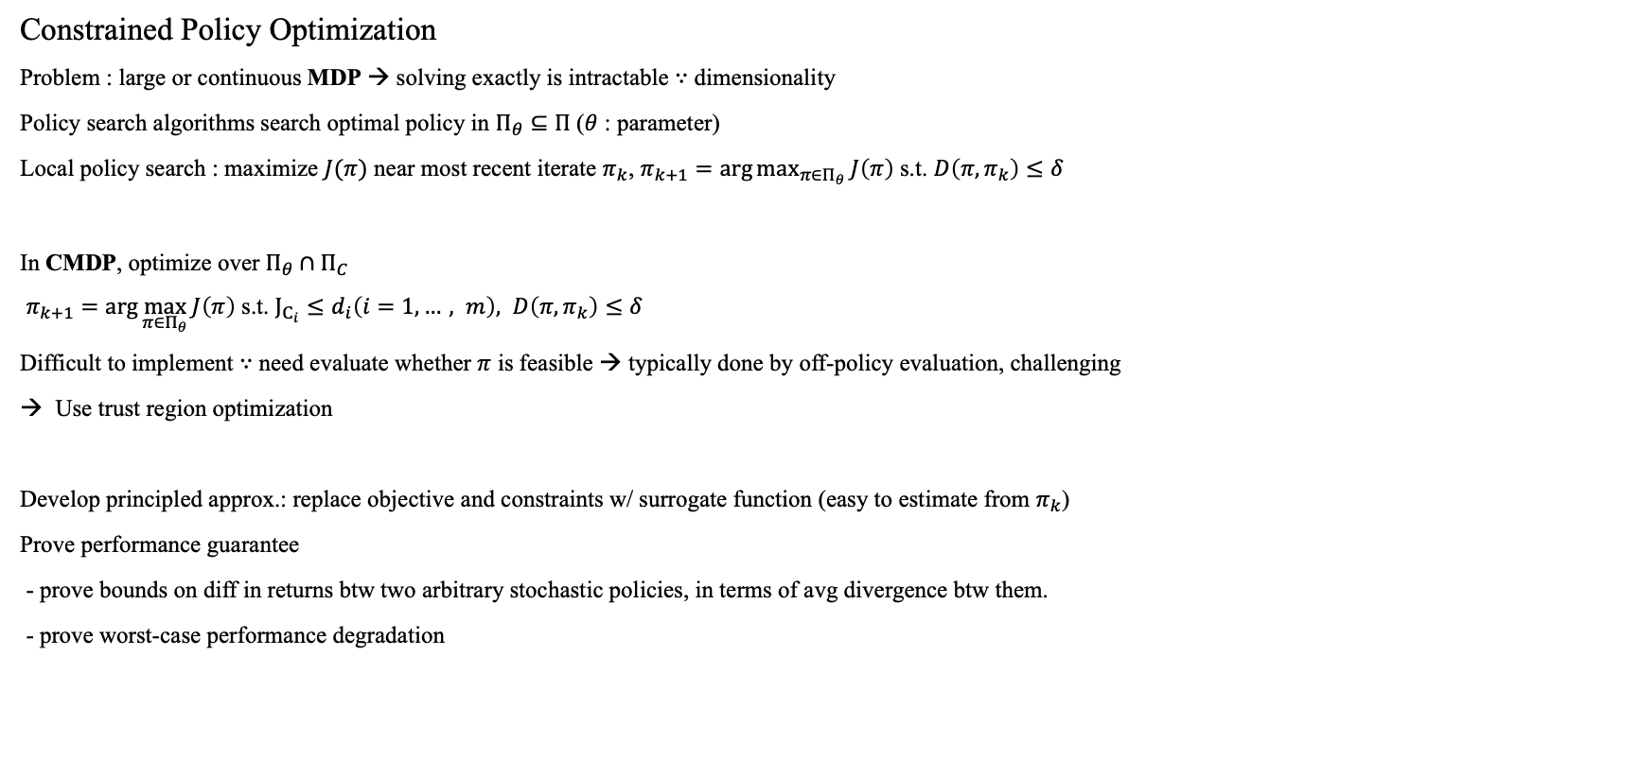


Constrained Policy Optimization
$$π_{k}$$
Constrained Policy Optimization
Problem : large or continuous MDP → solving exactly is intractable $∵$ dimensionality
Policy search algorithms search optimal policy in $Π_{θ}⊆Π$ ($θ$ : parameter)
Local policy search : maximize $J(π)$ near most recent iterate $π_{k}$, $π_{k+1}=\arg{\max_{π∈Π_{θ}}{J\left(π\right)}}$ s.t. $D\left(π, π_{k}\right)≤δ$
In CMDP, optimize over $Π_{θ}∩Π_{C}$
$π_{k+1}=\arg{\max_{π∈Π_{θ}}{J\left(π\right)}}$ s.t. $J_{C_{i}}≤d_{i}\left(i=1, …, m\right), D\left(π, π_{k}\right)≤δ$
Difficult to implement $∵$ need evaluate whether $π$ is feasible → typically done by off-policy evaluation, challenging
Use trust region optimization
Develop principled approx.: replace objective and constraints w/ surrogate function (easy to estimate from $π_{k}$)
Prove performance guarantee
- prove bounds on diff in returns btw two arbitrary stochastic policies, in terms of avg divergence btw them.
- prove worst-case performance degradation
$$δ$$
$$π_{k+1}$$

Slide 13
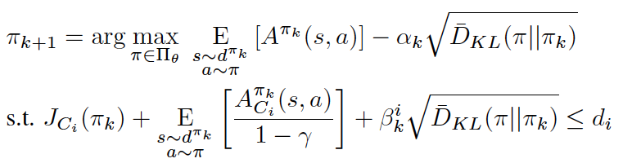
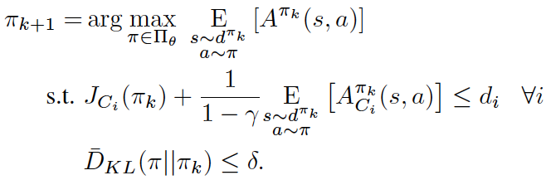
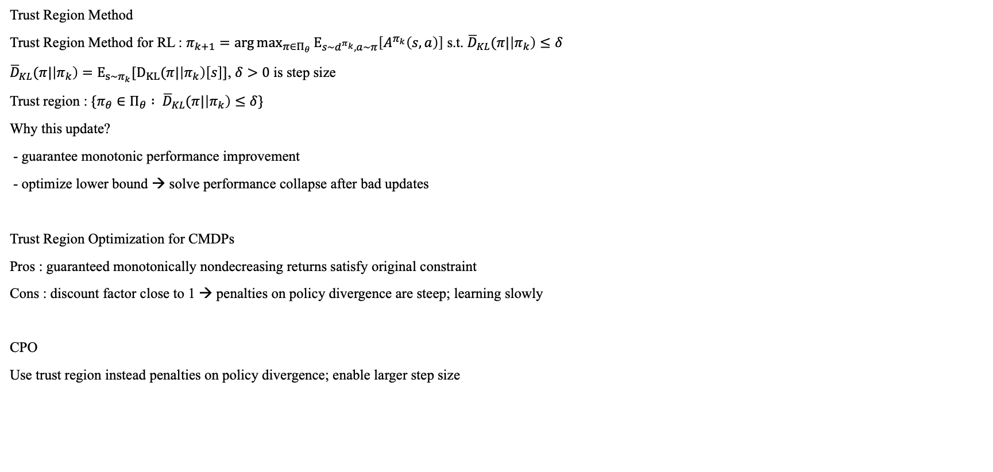
Constrained Policy Optimization
Trust Region Method
Trust Region Method for RL : $π_{k+1}=\arg{\max_{π∈Π_{θ}}{E_{s\sim d^{π_{k}}, a\sim π}\left[A^{π_{k}}\left(s, a\right)\right]}}$ s.t. ${\overline{D}}_{KL}(π|\left|π_{k}\right)≤δ$
${\overline{D}}_{KL}(π|\left|π_{k}\right)=E_{s\sim π_{k}}[D_{KL}(π|\left|π_{k}\right)\left[s\right]]$, $δ>0$ is step size
Trust region : $\{π_{θ}∈Π_{θ} : {\overline{D}}_{KL}(π|\left|π_{k}\right)≤δ\}$
Why this update?
- guarantee monotonic performance improvement
- optimize lower bound → solve performance collapse after bad updates
Trust Region Optimization for CMDPs
Pros : guaranteed monotonically nondecreasing returns satisfy original constraint
Cons : discount factor close to 1 → penalties on policy divergence are steep; learning slowly
CPO
Use trust region instead penalties on policy divergence; enable larger step size

Slide 14
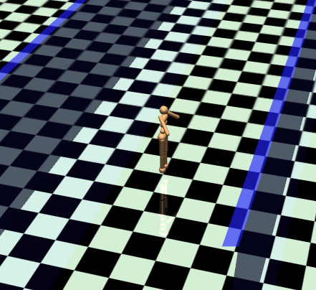
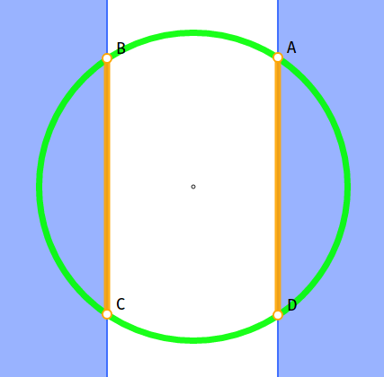
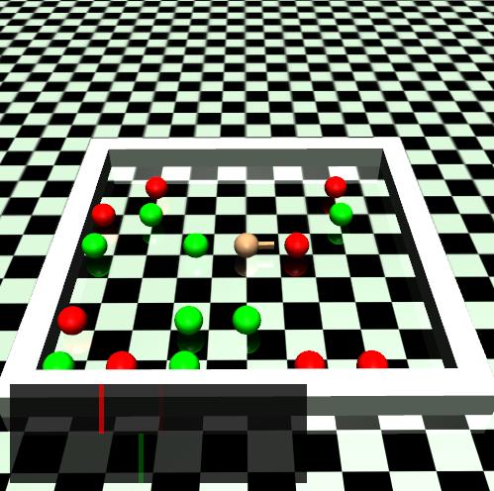
Experiments
Questions:
1. CPO succeed satisfy constraints + trained w/ thousands of parameters?
2. CPO vs. prime-dual optimization : baseline, constraint
3. Constrain cost upper bound vs. directly constrain cost
4. Constraint vs. fixed penalties
Design experiment
Circle
reward – run wide circle
constrain – stay within target circle
2. Gather
reward – collect apple
constrain – avoid red bomb

Slide 15
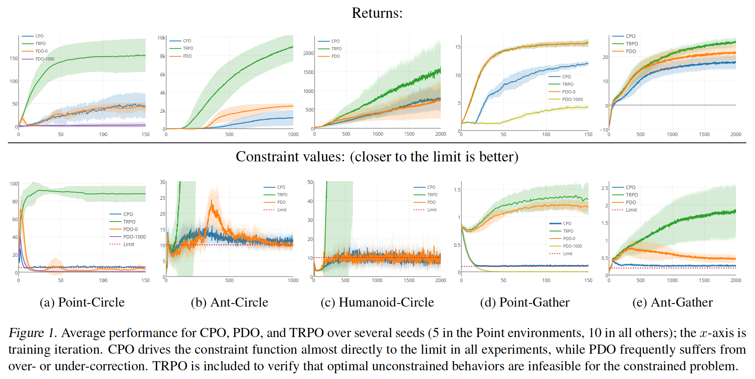

Experiments
3 agents
point-mass
quadruped robot
Simple humanoid
Use neural network policies w/ two hidden layers
of size (64, 32)
Evaluate based on C⁺ return
$C_{i} :S×A×S→ℝ$ : auxiliary cost function
To account approximation, build factor of safety to minimize constraint violation.
$C_{i}^{+}\left(s, a, s^{′}\right)=C_{i}\left(s, a, s^{′}\right)+Δ_{i}(s, a, s^{′})$ : constrain upper bounds on original constrain
*$Δ_{i}\left(s, a, s^{′}\right)→ℝ_{+}$ : probability of entering an unsafe state within a fixed time horizon.
y-axis: avg performance over several seeds
x-axis: training iteration
*TRPO : Trust region policy optimization
- state-of-the-art unconstrained RL algorithm
Notes:
범위로 나타나는 이유 : C+ return 이기 때문에

Slide 16

Experiments
CPO - successful at approximately enforcing constraints in all environments.
PDO
- usually converges to constraint satisfying policies in the end
- not consistently constraint-satisfying throughout training (spike at Ant-Circle)
- sensitive to initial value
PDO-0 : initialize $v_{0}=0$
- no prior knowledge
PDO-1000 : initialize $v_{0}=1000$
- PDO more conservative w.r.t. constraint
- low performance
Notes:
범위로 나타나는 이유 : C+ return 이기 때문에

Slide 17
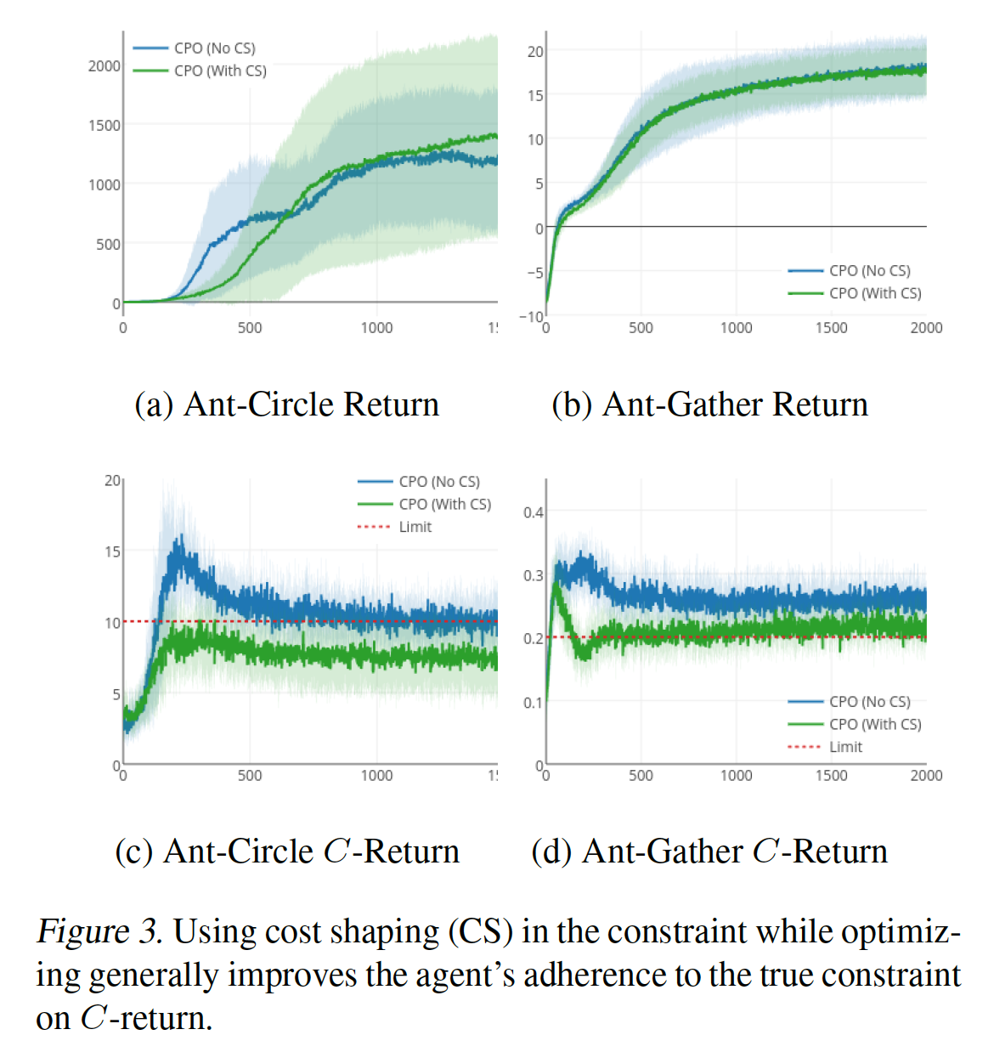
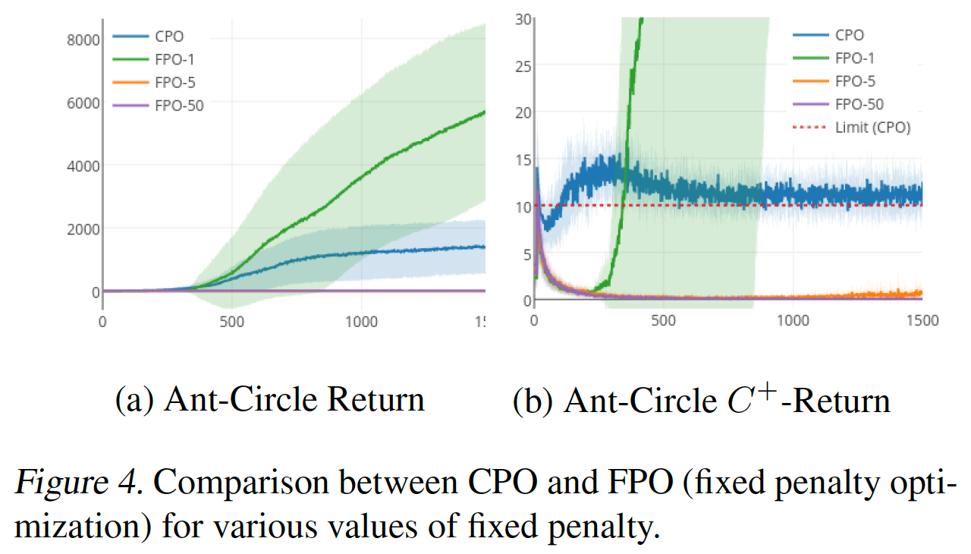
Experiments
Questions:
CPO succeed satisfy constraints + trained w/ thousands of parameters?
2. CPO vs. prime-dual optimization : baseline, constraint
- CPO outperforms PDO on enforcing constraint
– w/o compromising performance w.r.t. return
3. Constrain cost upper bound vs. directly constrain cost
- cost shaping help, almost accounting CPO’s inherent approximation errors
- However, CPO satisfy constraint w/o cost shaping.
4. Constraint vs. fixed penalties
- Constraint – CPO / fixed penalties – TRPO
- fixed penalties highly sensitive to penalty coefficient
penalty coefficient 1 : reward maximize / accumulate massive constraint costs
penalty coefficient 5 : cost minimize → never get reward
- CPO : automatically pick penalty coefficient → reach balance btw reward / constraint
Notes:
범위로 나타나는 이유 : C+ return 이기 때문에

Slide 18
What I’ve done and to do…
Reviewing paper
Done
- understand what the paper wants to suggest
To do
- recall Probability and Introductory Random Process
- study reinforce learning (MDP, CMDP, prime-dual, … )
- understand equation in the paper in detail
Realizing(or executing) the paper
Stuck at downloading rllab due to difference in architecture (x86-64, aarch64)
Also, lots of missing materials written in the script
Way to solve
- Download every dependency step by step
- use garage...?
may or may not be able to succeed…
Notes:
범위로 나타나는 이유 : C+ return 이기 때문에

